Slide 1
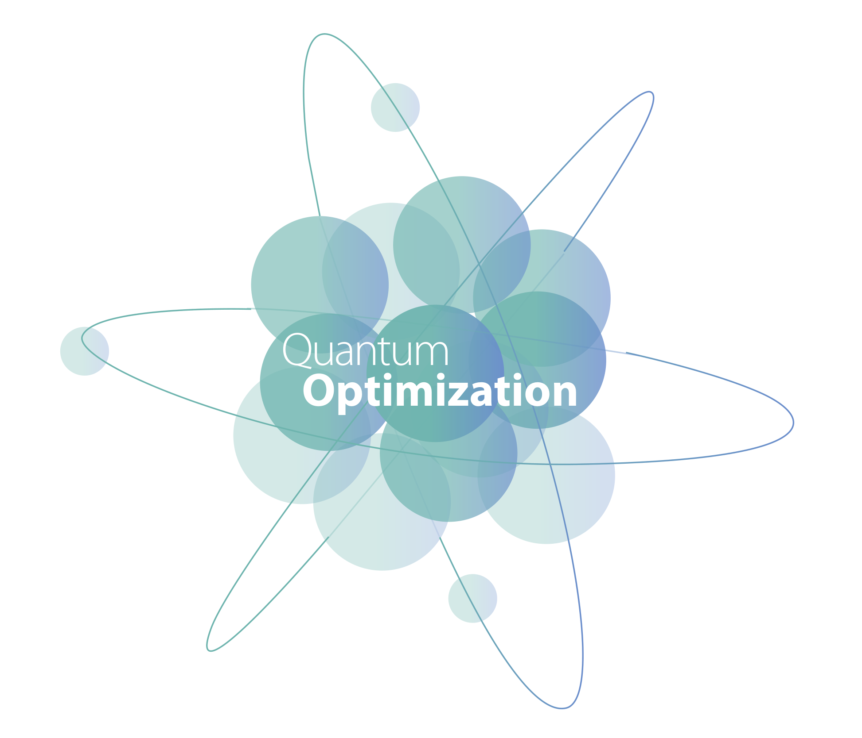


Alejandro Giraldo Quintero
Computer Science and Engineering
PhD Candidate

Slide 2

Quantum Computing

Slide 3
Milestones
1965
Feynman: The Development of the Space-Time View of Quantum Electrodynamics
1980
1985
Yuri Manin: Propose the first idea of Quantum Computing
David Deutsch: Quantum theory, the Church-Turing principle and the universal quantum computer
1994
Peter Shor: Algorithm to find prime factors of a number
2000
First working 5-qubit NMR. Technical University of Munich
2001
IBM: 5-qubit quantum processor available in the cloud IBM Q Experience
2016
2011
D-Wave: First commercially available Quantum Computer
IBM/Standford: 7-qubit computer, factor number 15
IBM Free: 125 qubit Pay: 1125 qubit Dwave: 4400

Slide 4
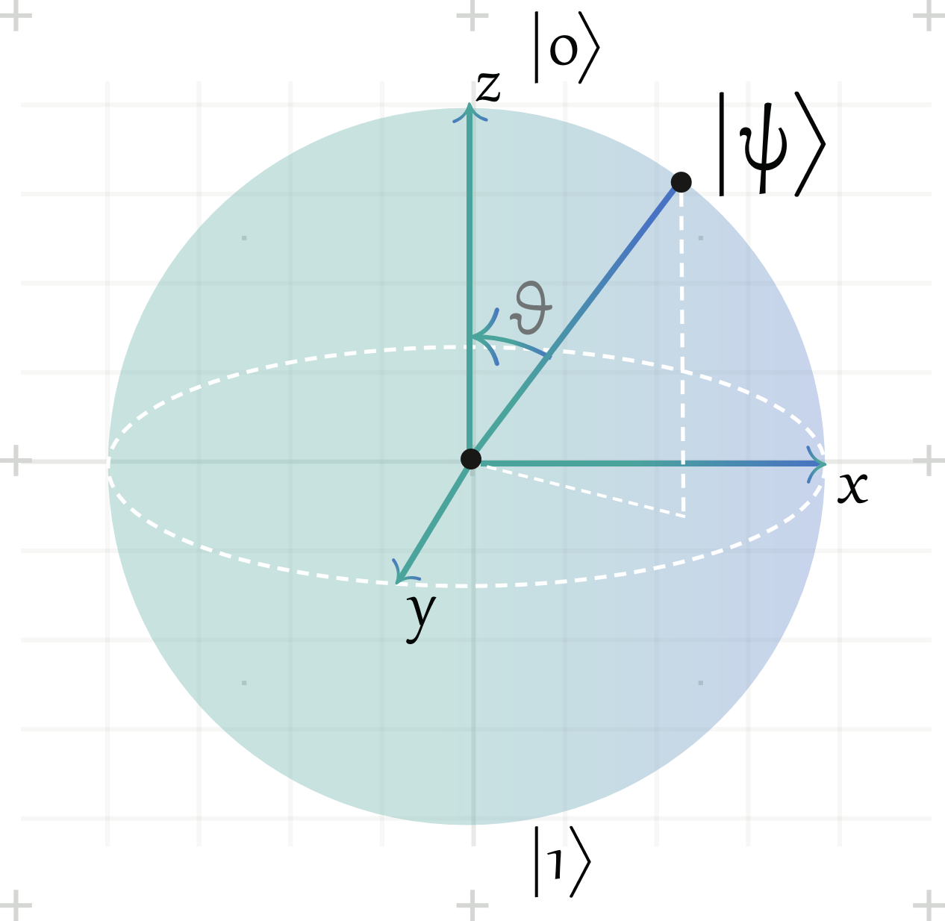
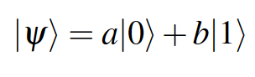
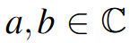
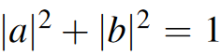
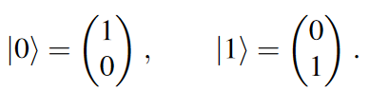
Qubit
Superposition
Interference
Entaglement

Slide 5
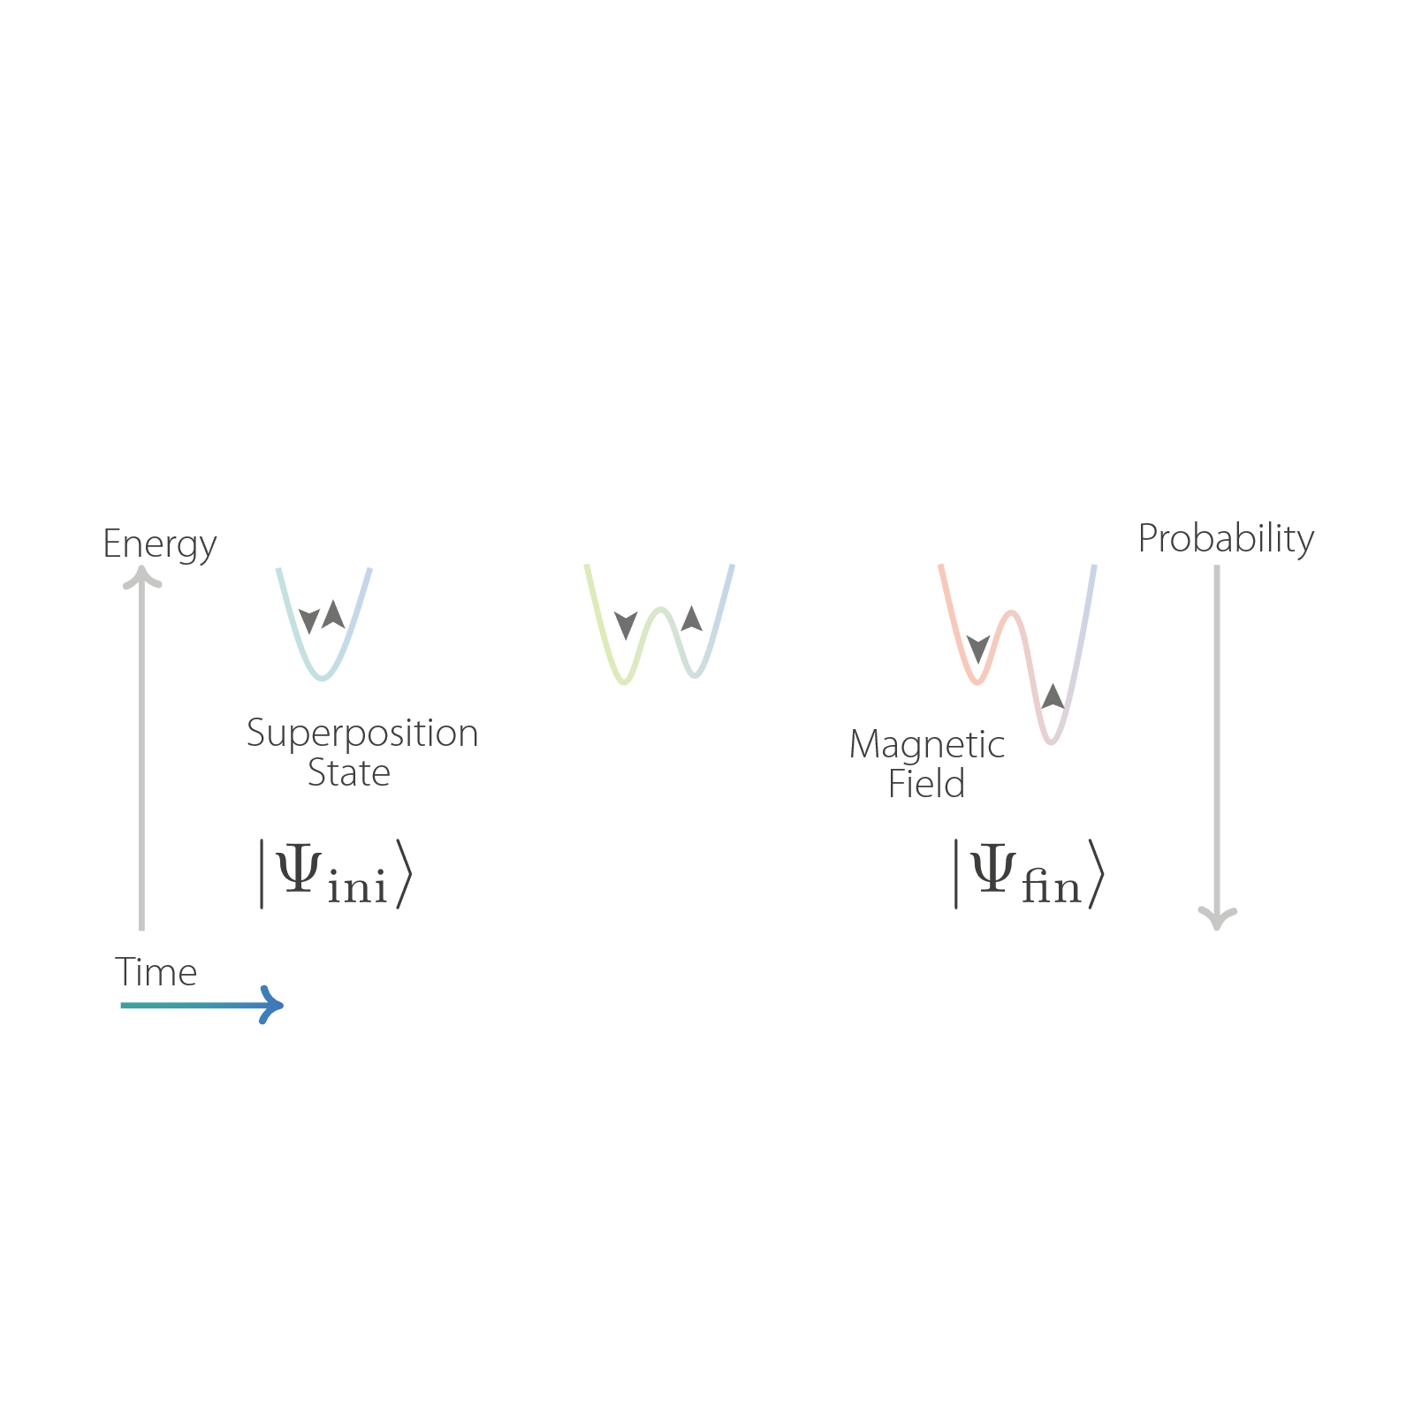
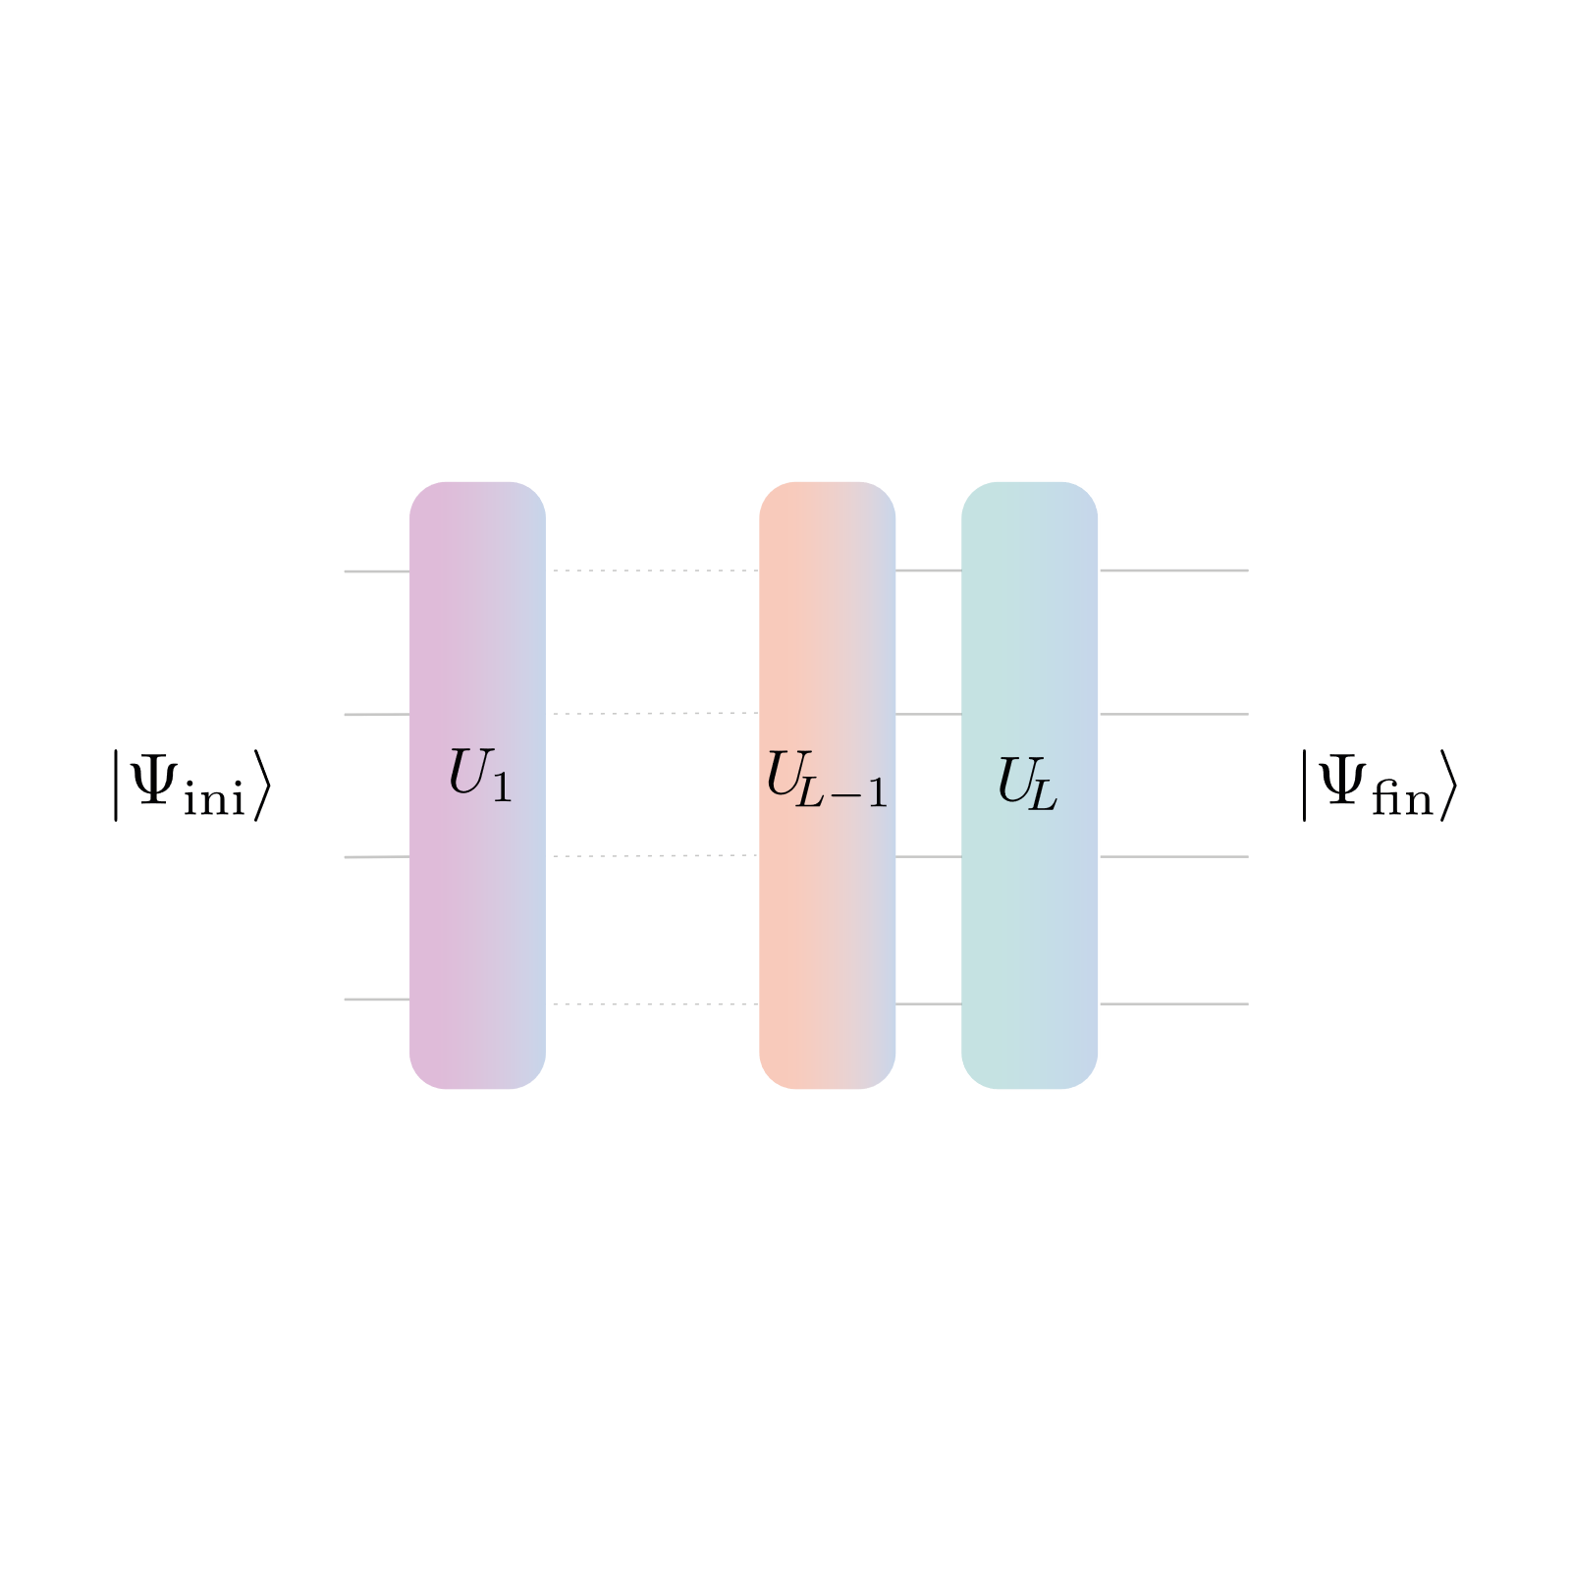
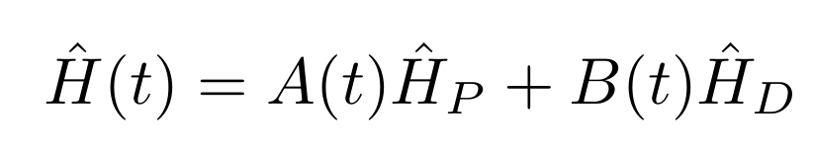
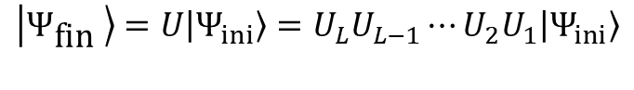
Approaches
Gates
Annealing
$$\left|Ψ_{\text{fin} }\right\rangle =U\left|Ψ_{ini}\right\rangle =U_{L}U_{L−1}⋯U_{2}U_{1}\left|Ψ_{ini}\right\rangle$$

Slide 6
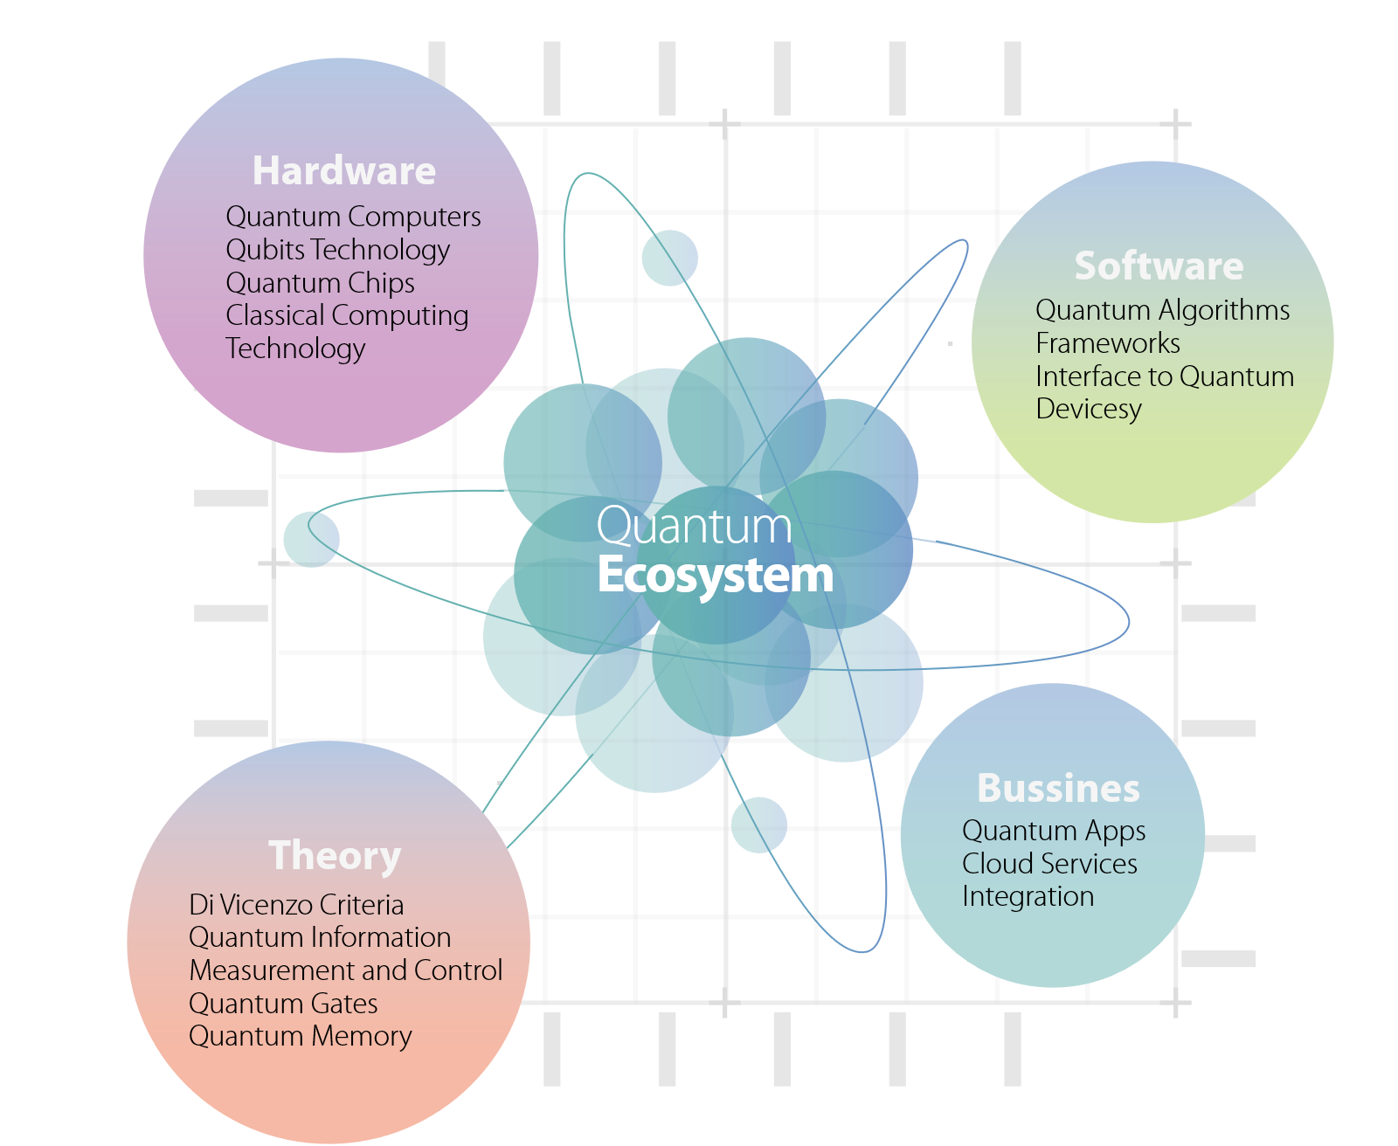

Slide 7
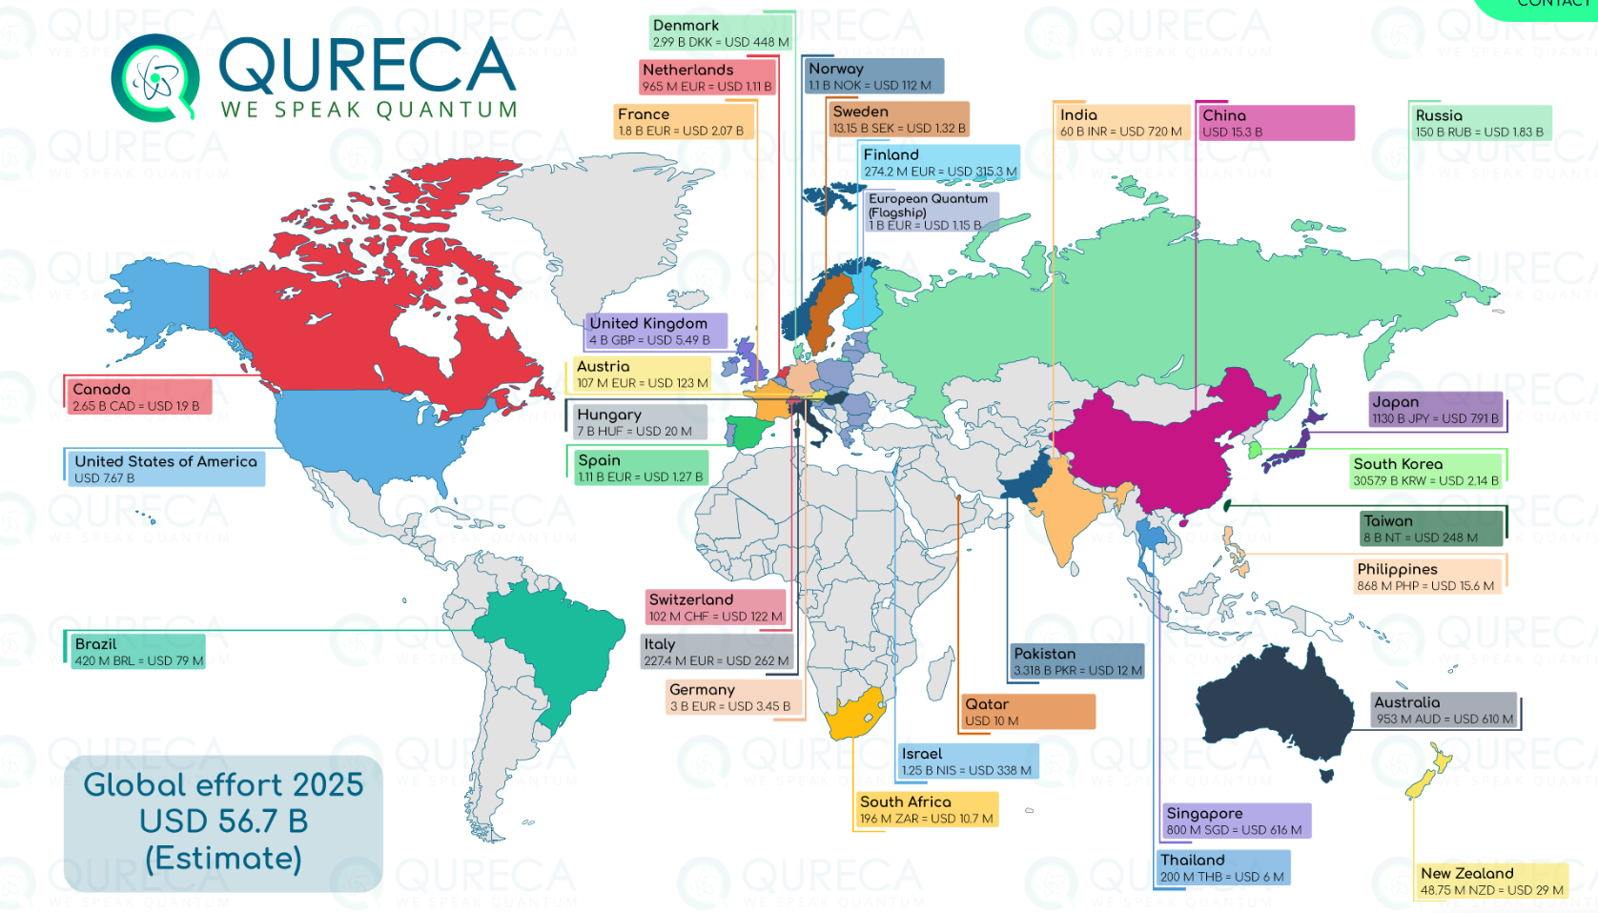

Slide 8
Main Research Areas:
Chemistry and materials
Optimization
Logistics
Machine Learning

Slide 9
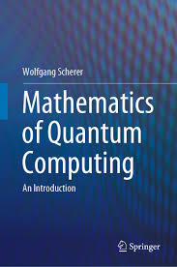
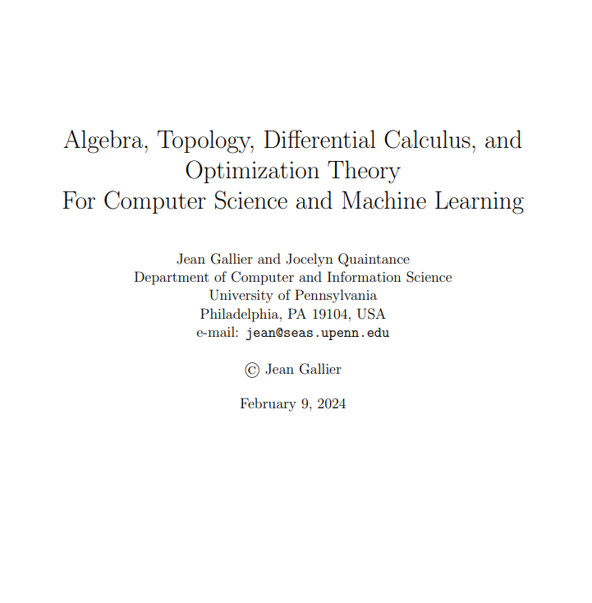
Tools
https://www.cis.upenn.edu/~jean/math-deep.pdf

Slide 10
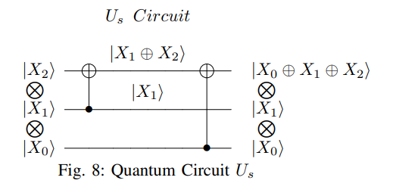
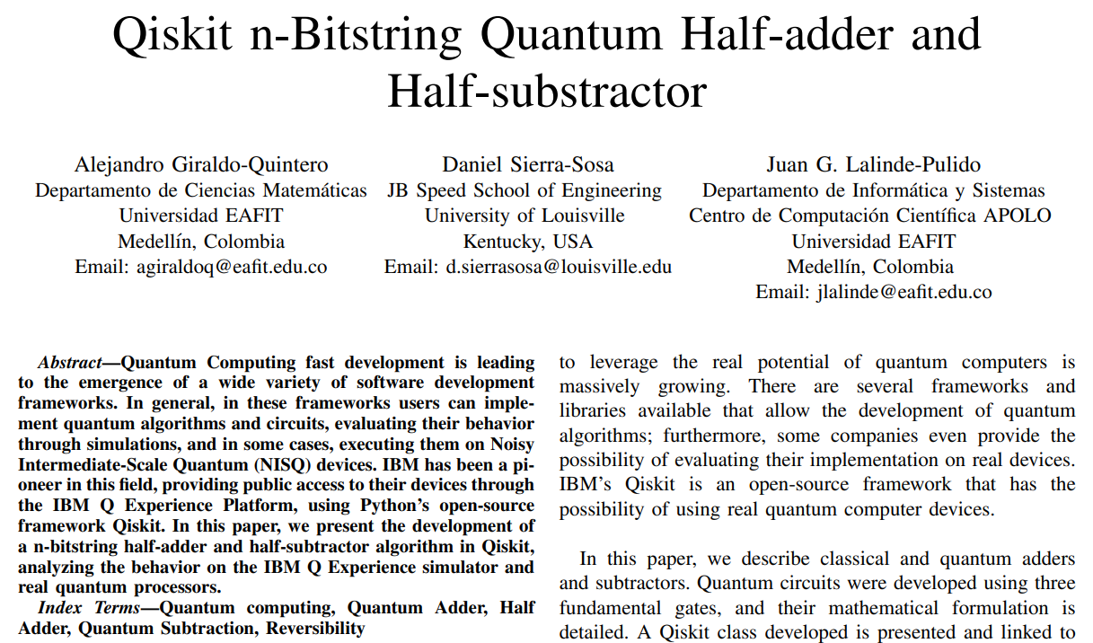
Basic Operations
https://ieeexplore.ieee.org/document/9408852

Slide 11
Optimization

Slide 12
Optimization
Lagrange
Newton
Leibniz
Gauss
Euler
Objective Function
Optimization Variables
Constraints
Metaheuristics
Lineal Prog
A.I.
Euclides

Slide 13
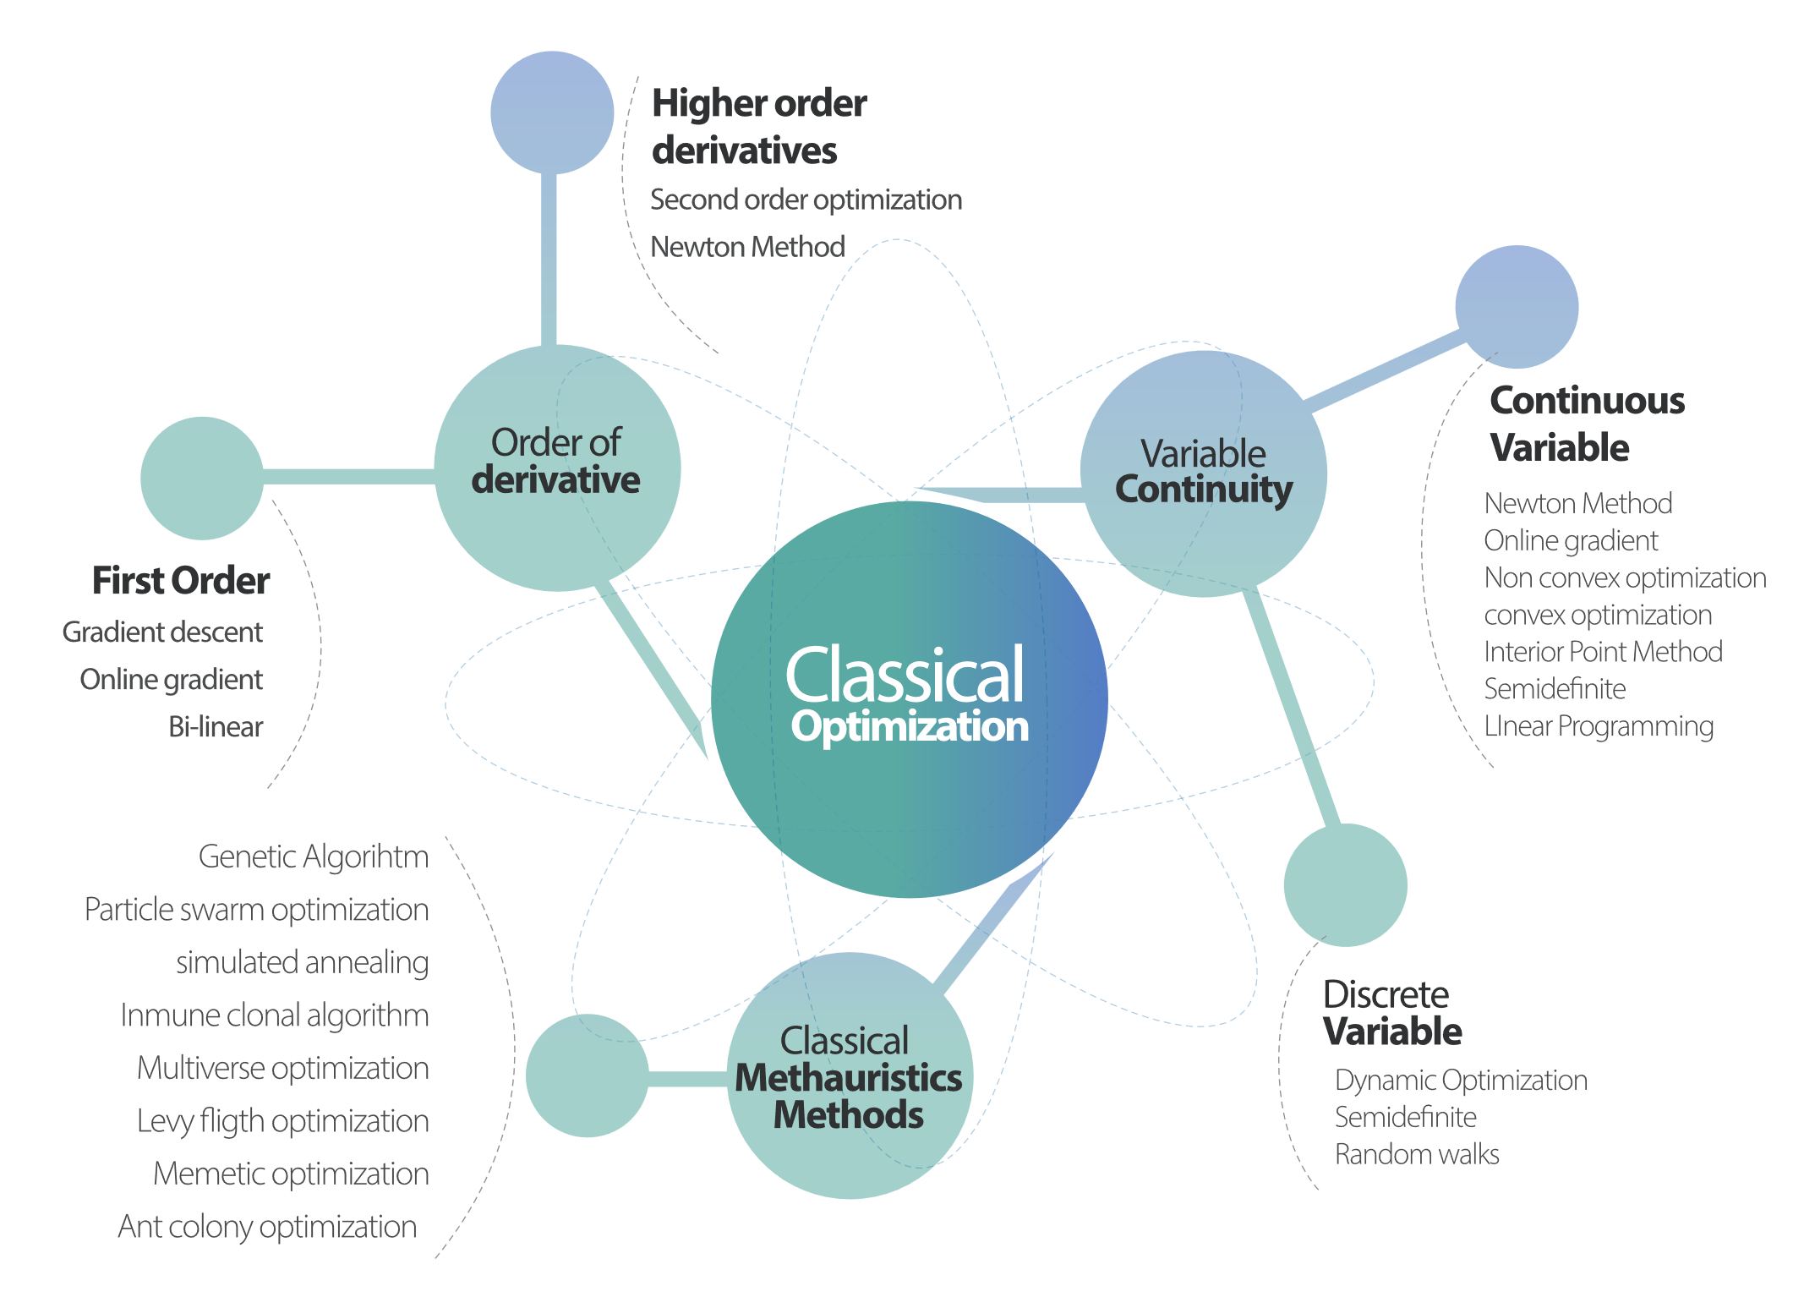

Slide 14
Quantum Optimization

Slide 15
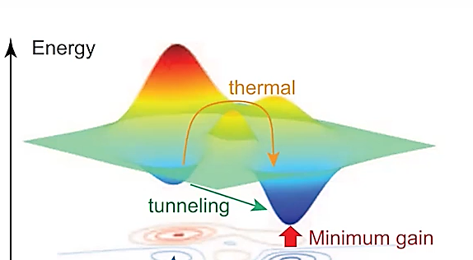

Slide 16
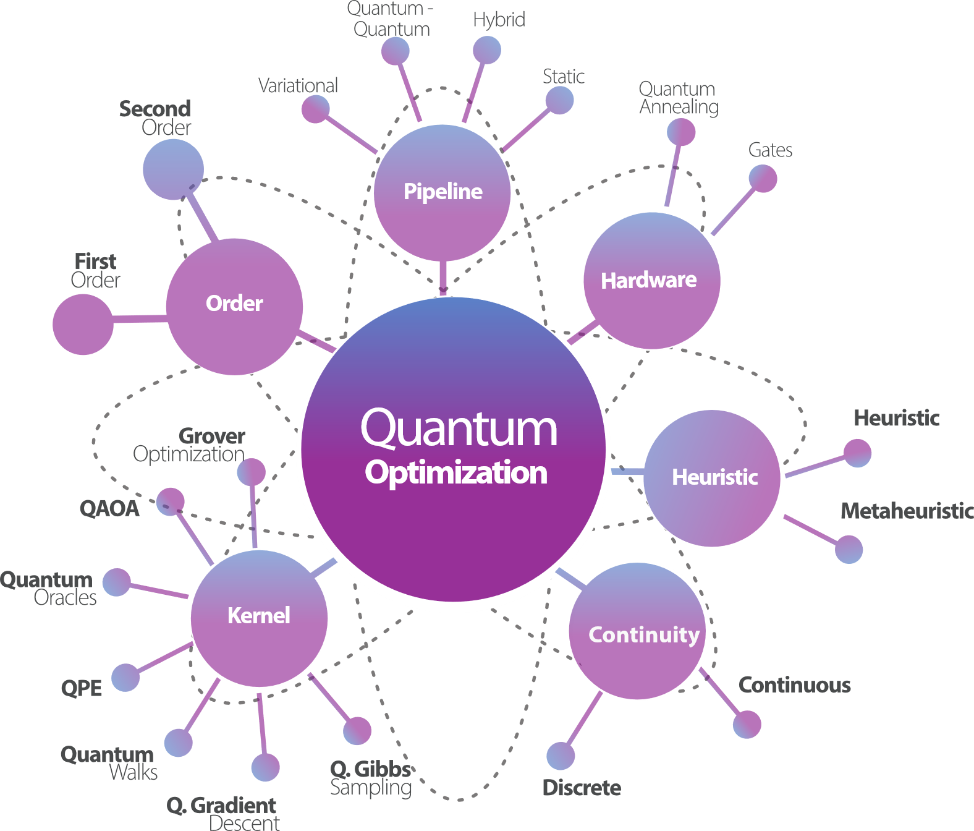

Slide 17
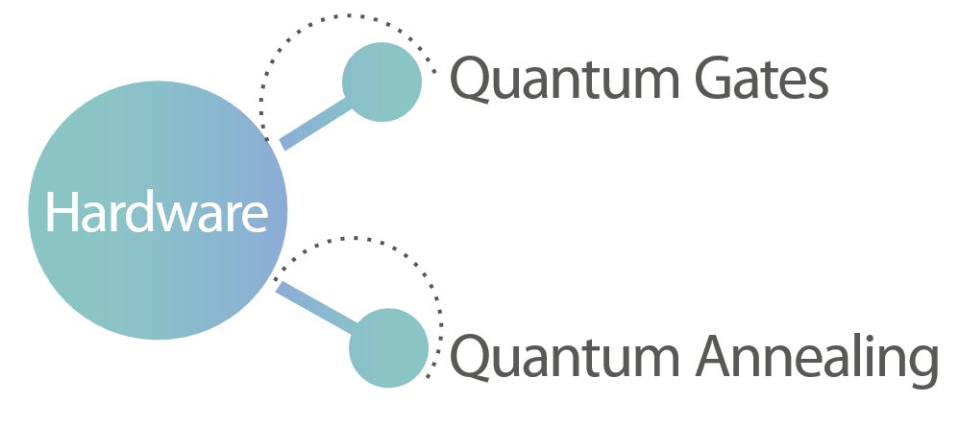
Clasification by Hardware

Slide 18
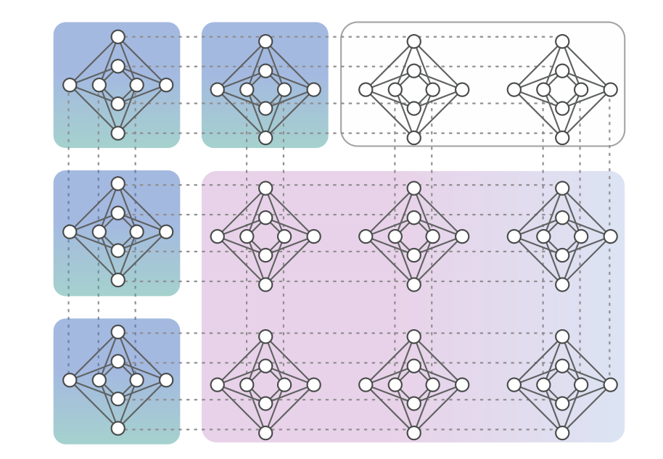
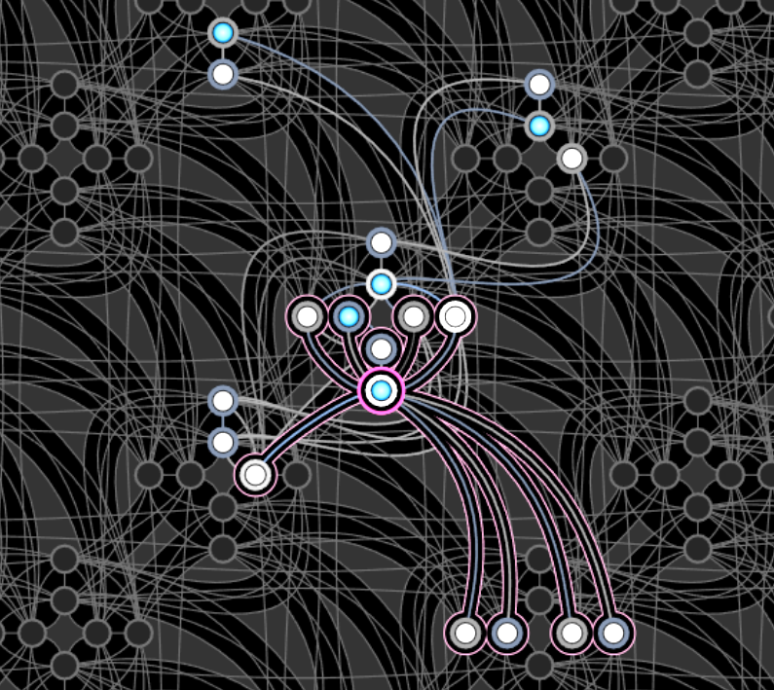
Hardware

Slide 19
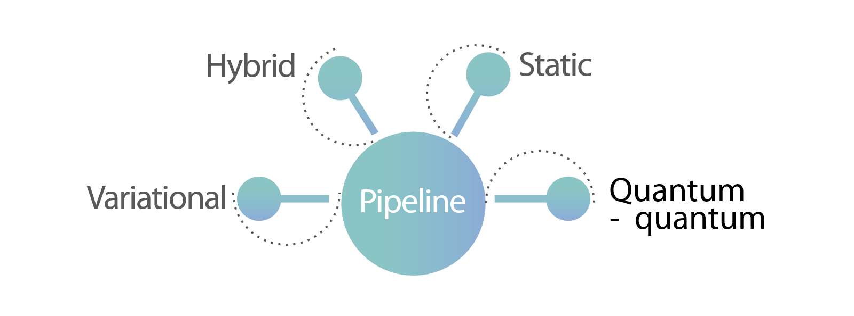
Clasification by Pipeline

Slide 20
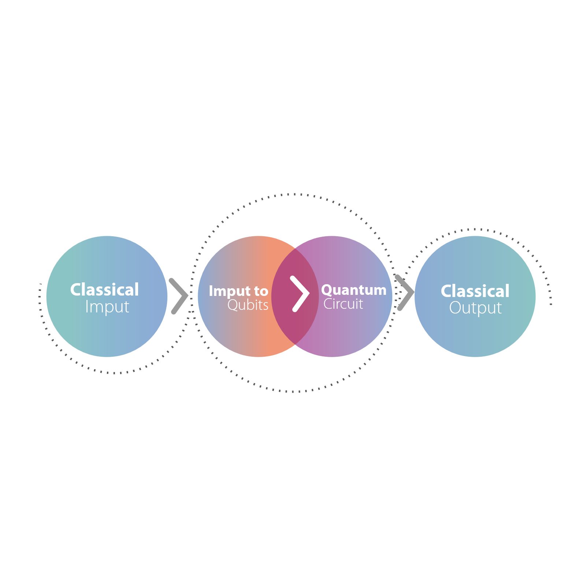
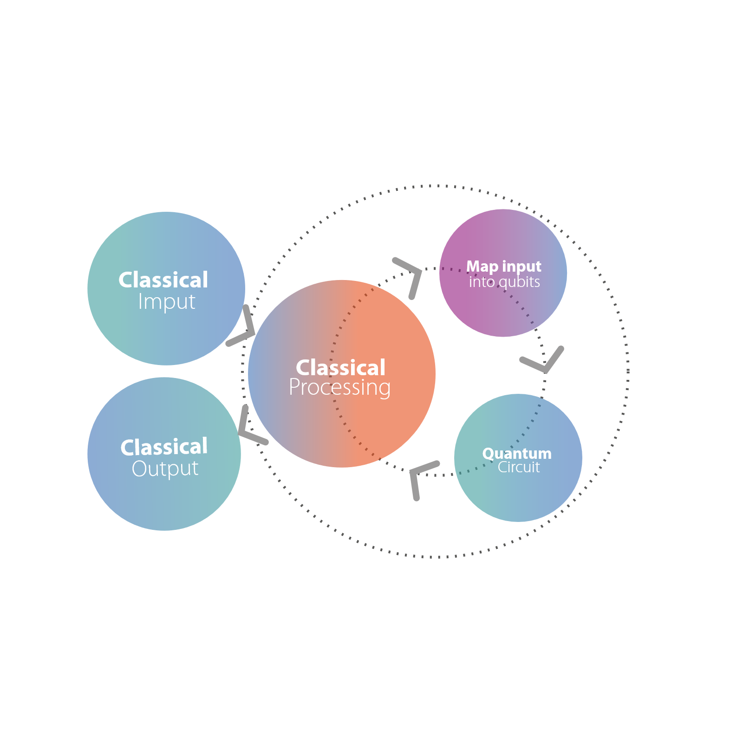
Static
Hybrid

Slide 21
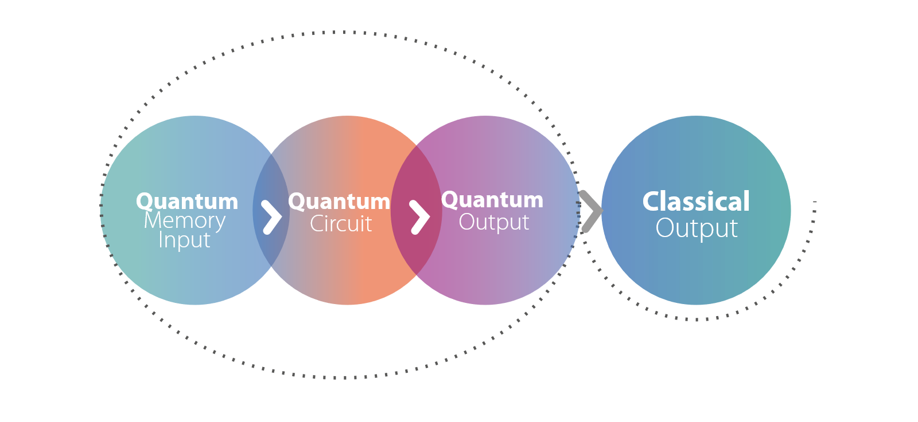
Quantum-Quantum

Slide 22
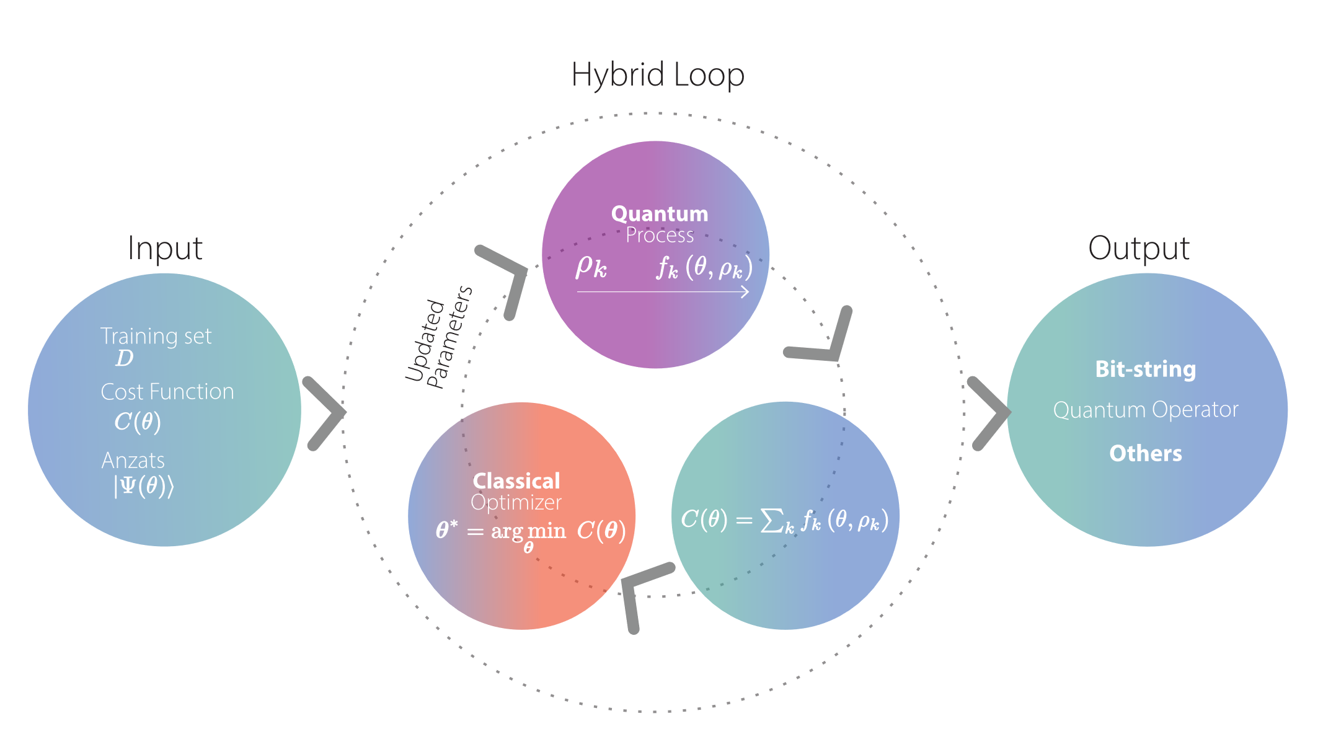
Variational

Slide 23
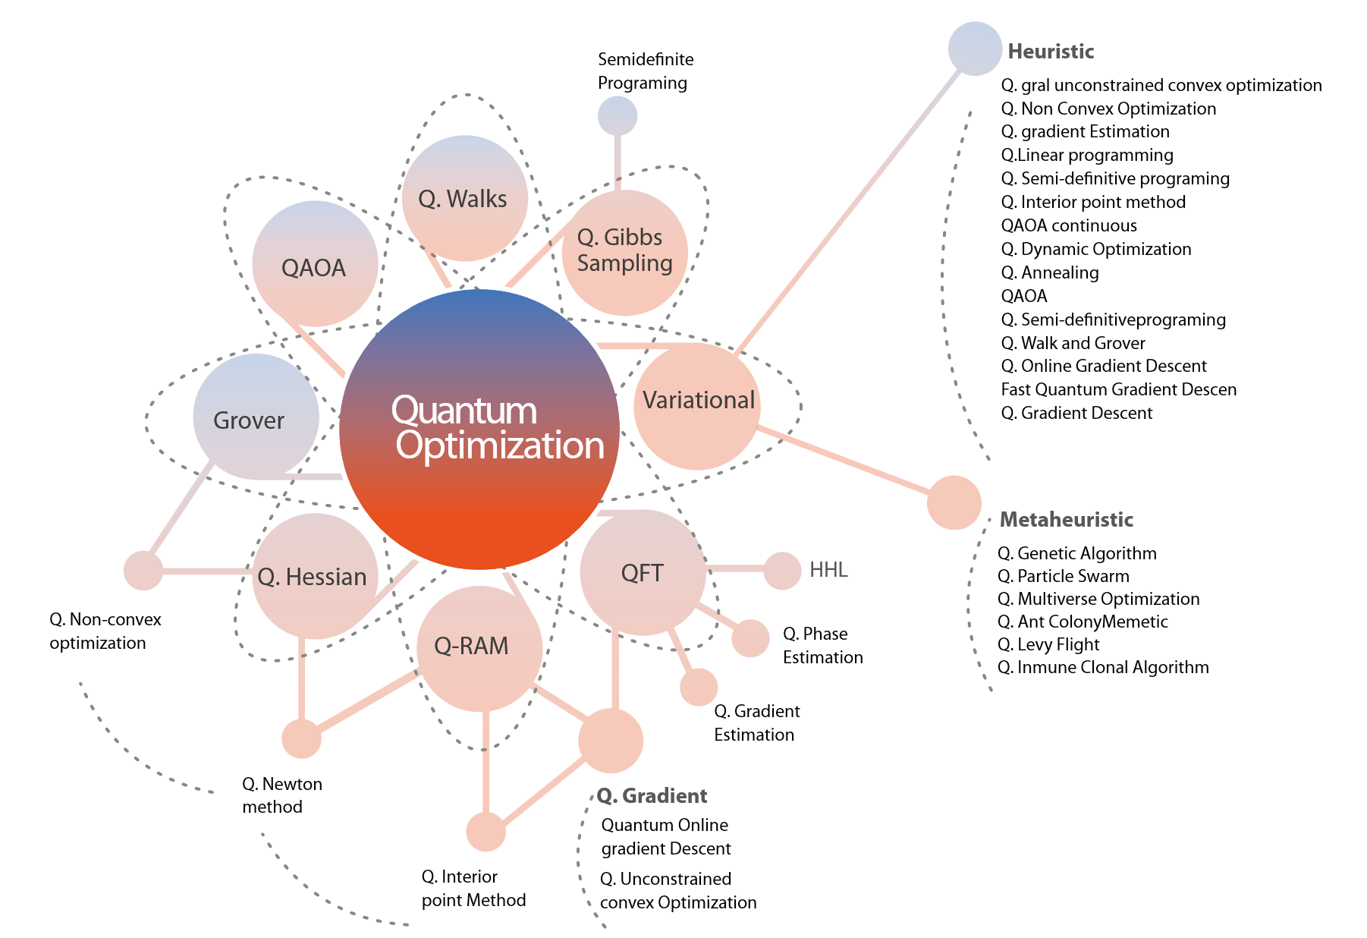
Clasification by Kernel

Slide 24
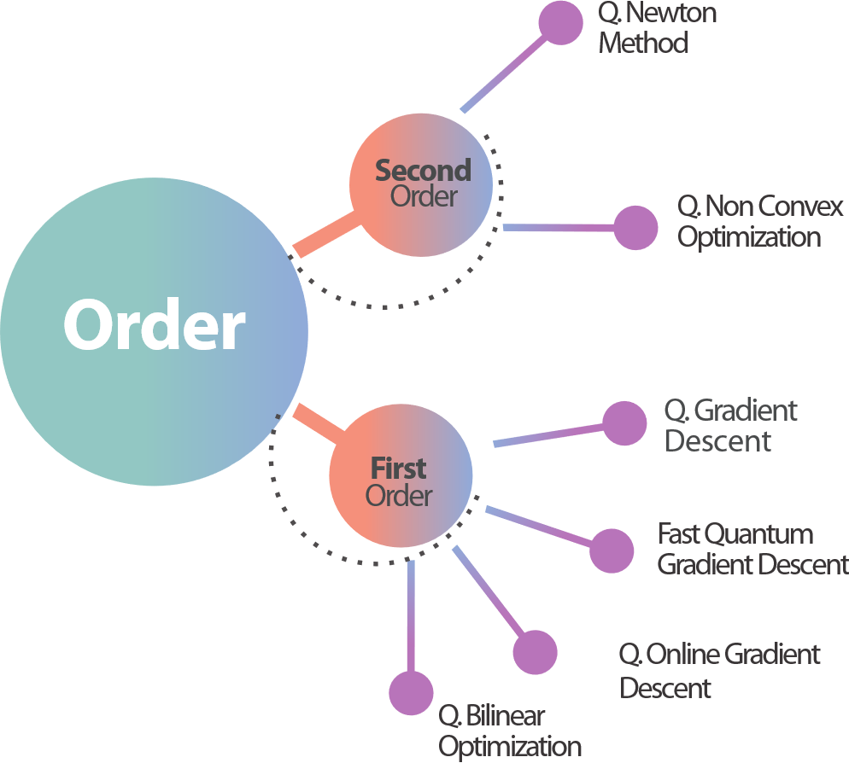
Clasification by Order

Slide 25
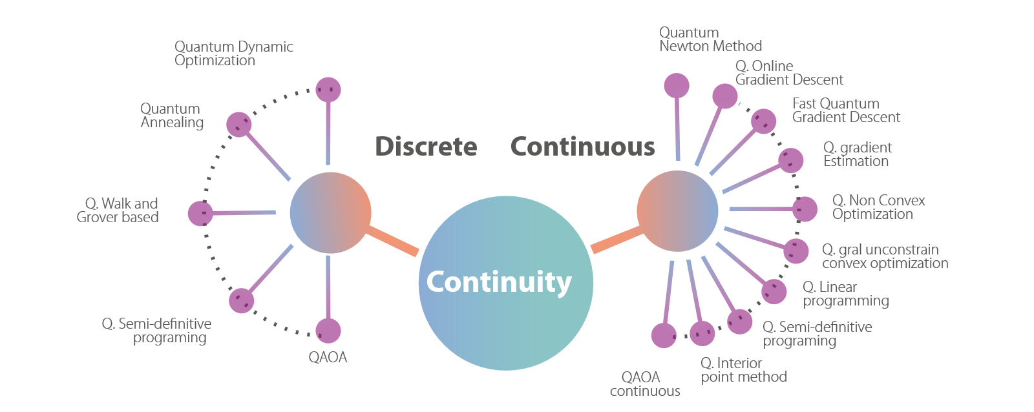
Clasification by Continuity

Slide 26
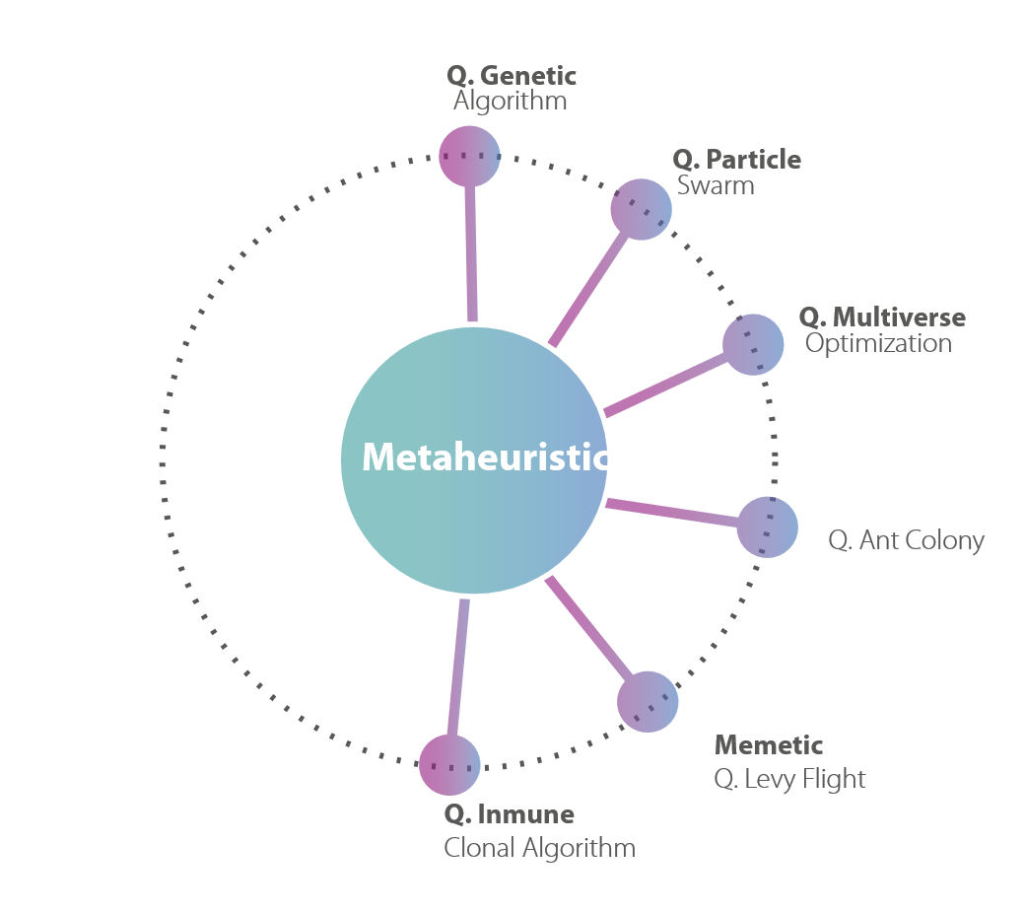
Clasification by Heuristic
And Metaheuristic

Slide 27
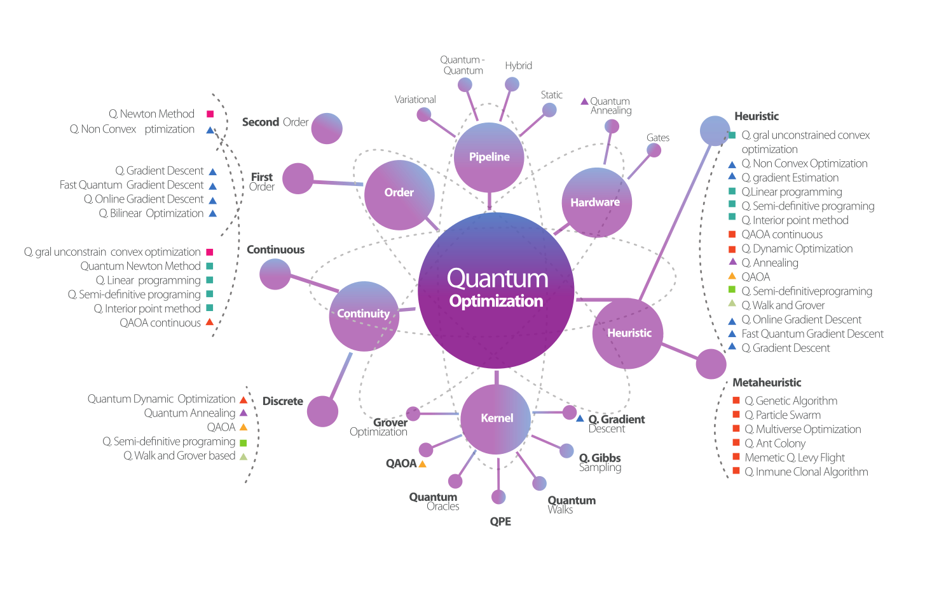

Slide 28
An Example

Slide 29
Example:
Quantum portfolio Optimization
Quantum portfolio optimization is the application of quantum computing techniques, especially quantum optimization algorithms, to the portfolio selection problem in finance.
It aims to find the best combination of assets that maximizes expected return while minimizing risk, under given constraints (like budget or diversification).

Slide 30
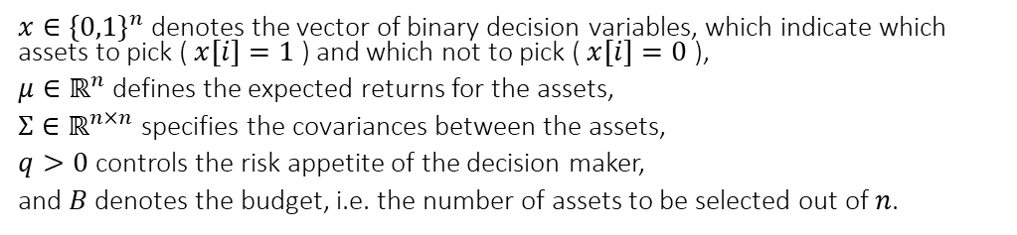
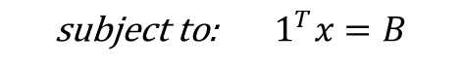
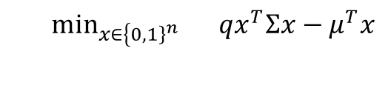
Example:
Optimization Problem
$$\begin{matrix} & \min_{x∈\left\{{\left.0,1\right\}}^{n}\right.} qx^{T}Σx−μ^{T}x \\ & \end{matrix}$$
$$\text{subject} \text{to}\text{: }{ 1}^{T}x=B$$
$x∈\{0,1\}^{n}$ denotes the vector of binary decision variables, which indicate which assets to pick ( $x[i]=1$ ) and which not to pick ( $x[i]=0$ ),
$μ∈ℝ^{n}$ defines the expected returns for the assets,
$Σ∈ℝ^{n×n}$ specifies the covariances between the assets,
$q>0$ controls the risk appetite of the decision maker,
and $B$ denotes the budget, i.e. the number of assets to be selected out of $n$.

Slide 31
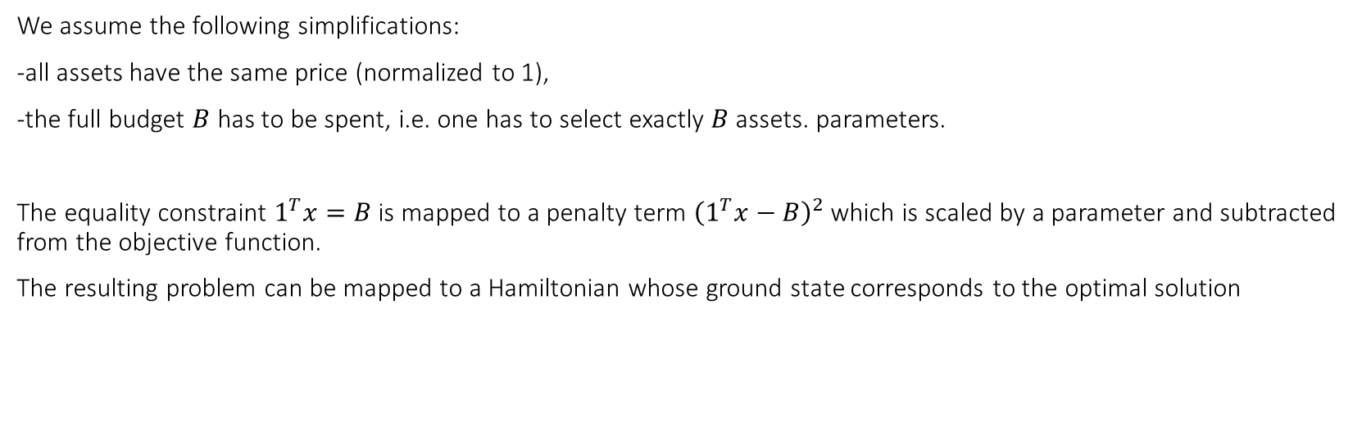
Example:
Optimization Problem
We assume the following simplifications:
all assets have the same price (normalized to 1),
the full budget $B$ has to be spent, i.e. one has to select exactly $B$ assets. parameters.
The equality constraint $1^{T}x=B$ is mapped to a penalty term ${\left(1^{T}x−B\right)}^{2}$ which is scaled by a parameter and subtracted from the objective function.
The resulting problem can be mapped to a Hamiltonian whose ground state corresponds to the optimal solution

Slide 32
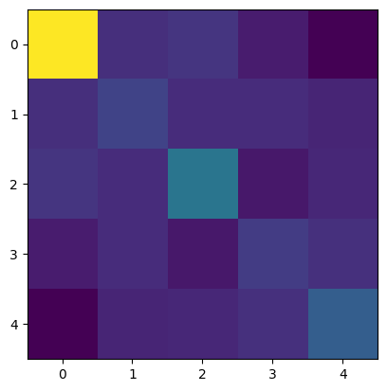
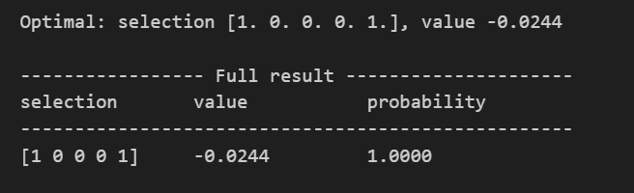
Example:
Instances
Output
Covariance Matrix

Slide 33
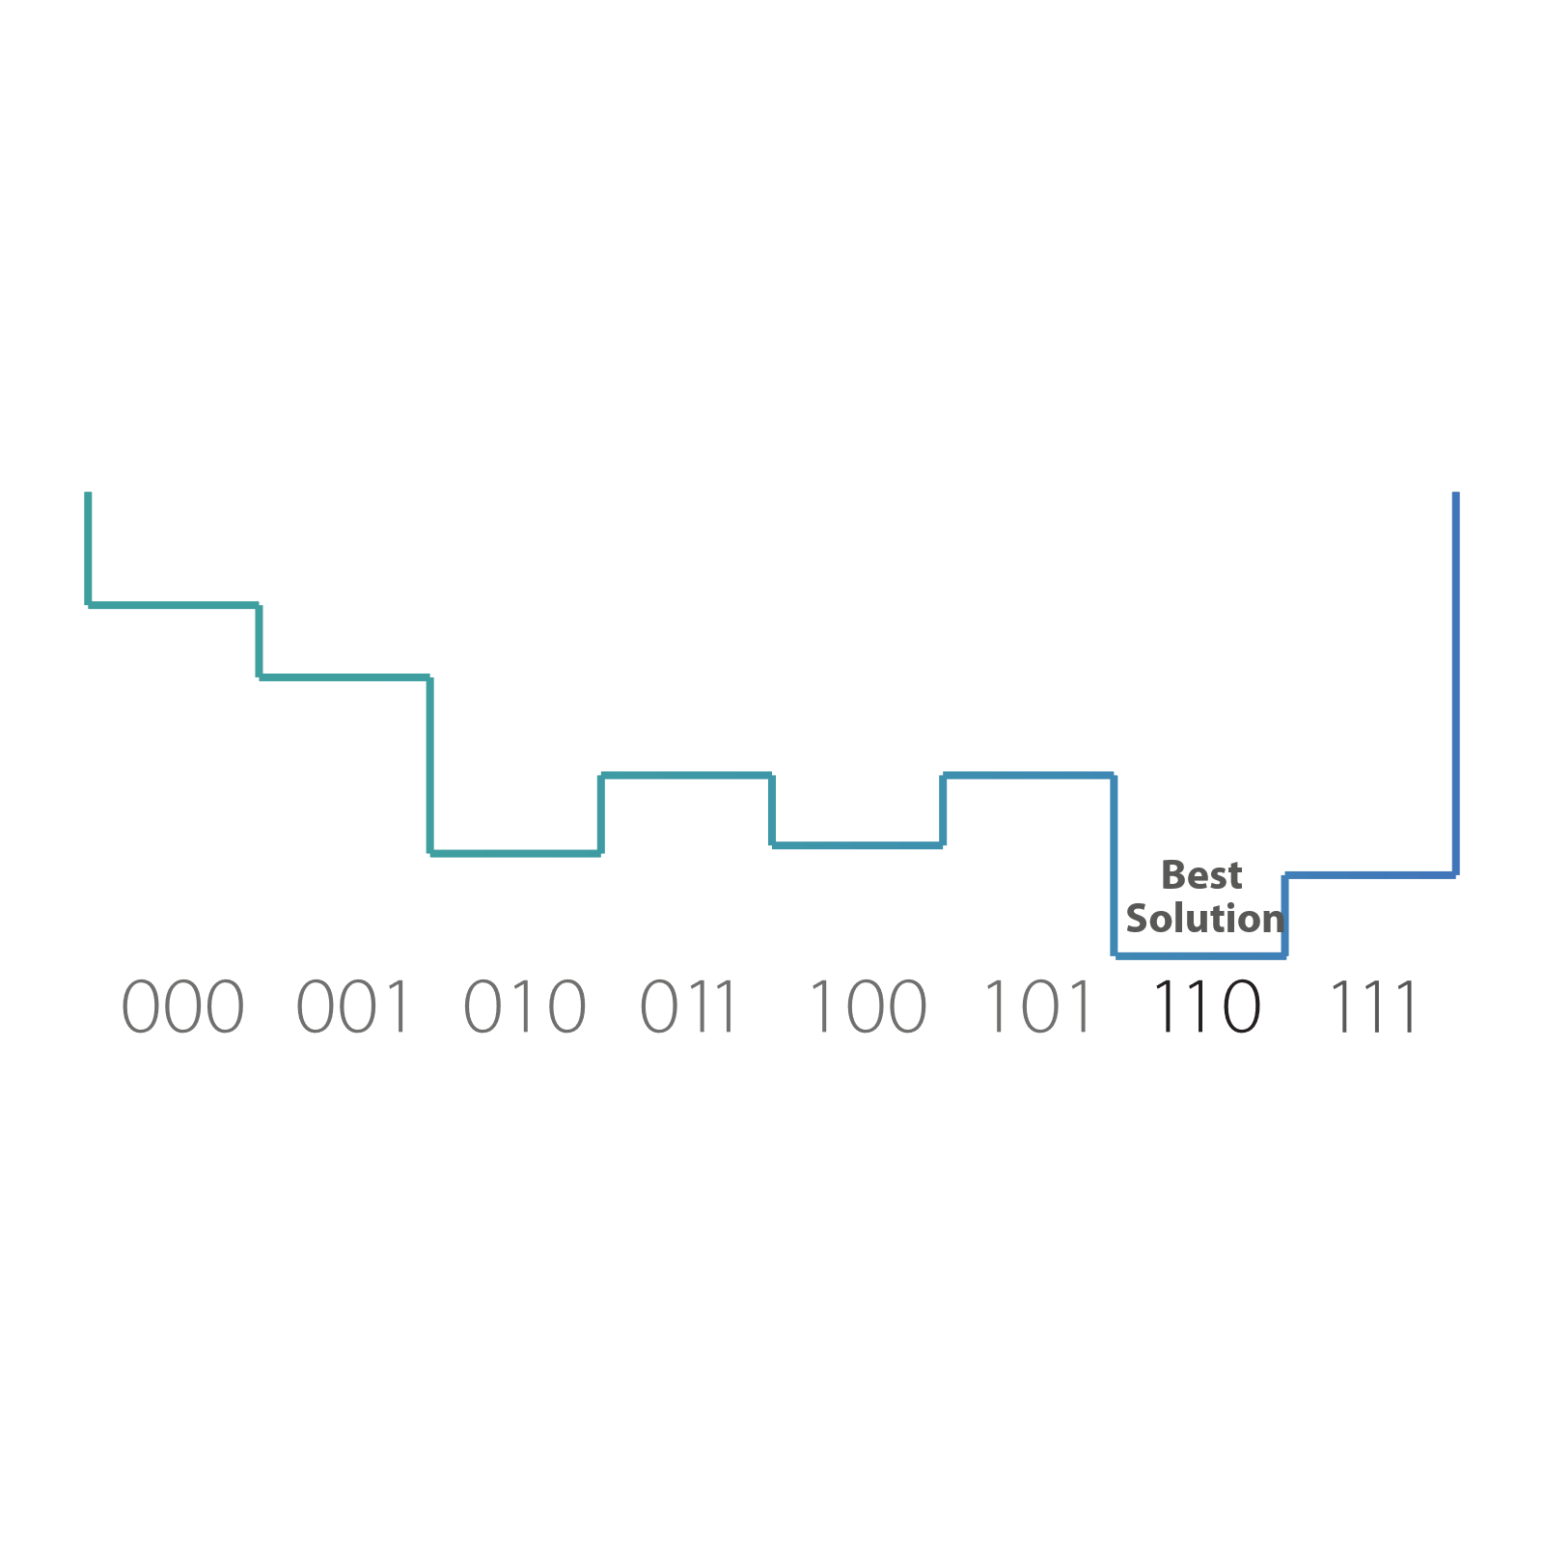
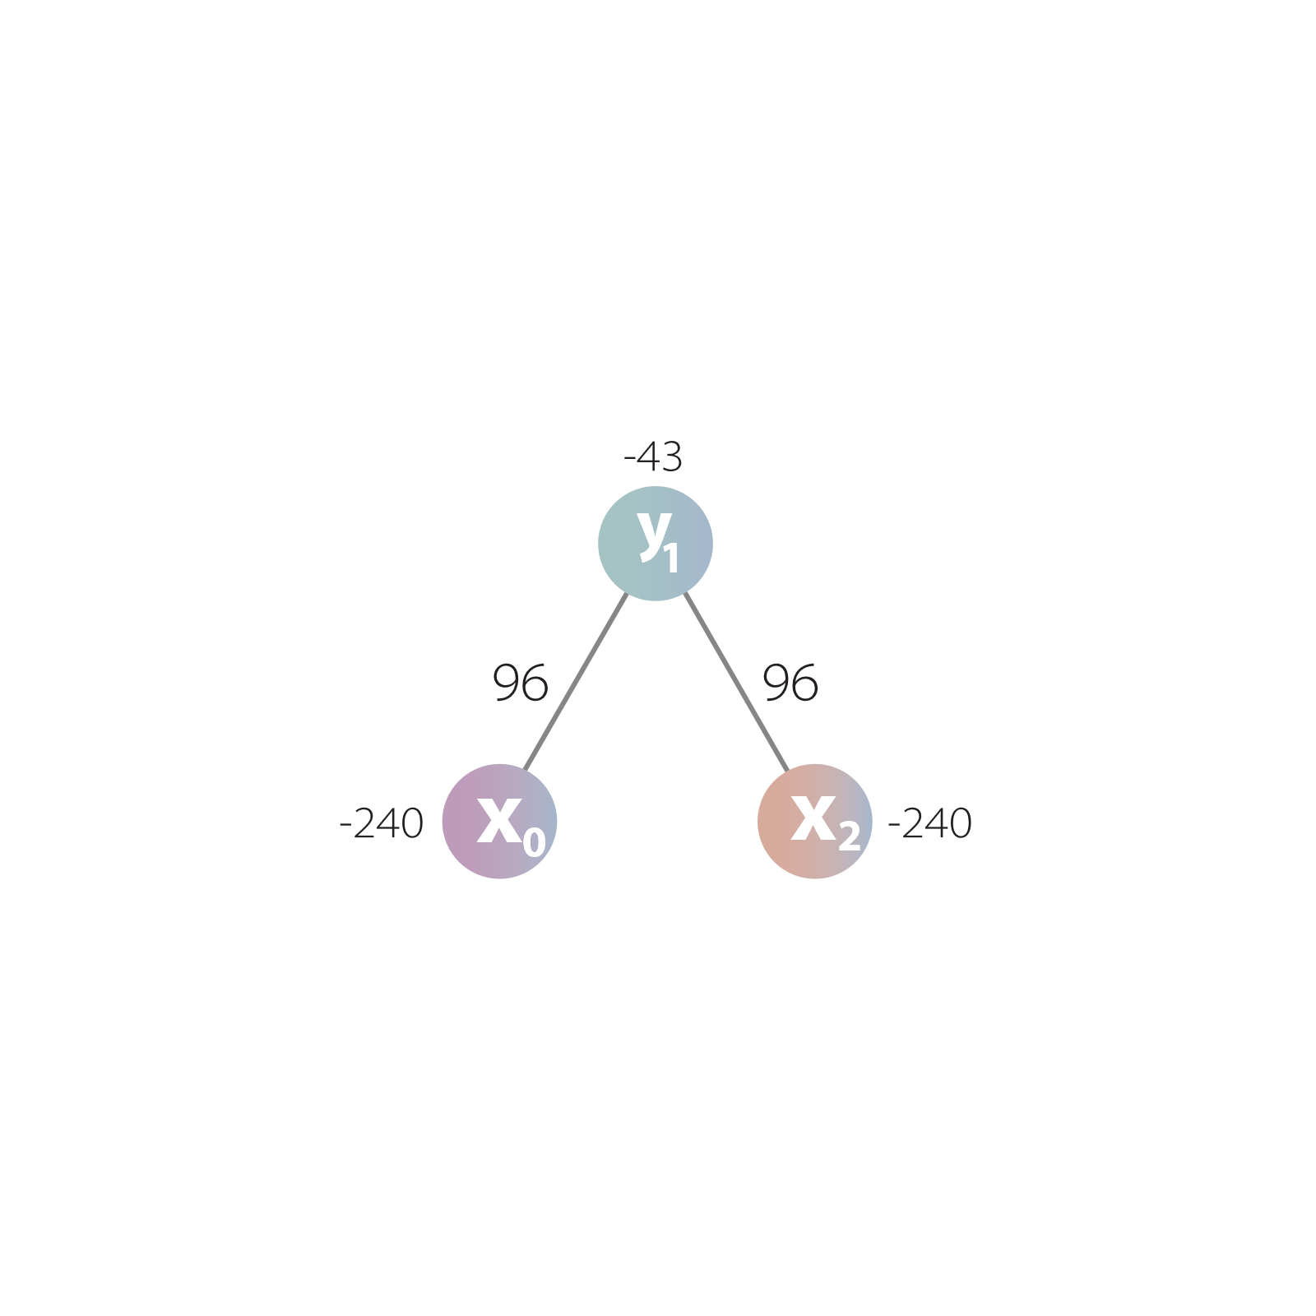
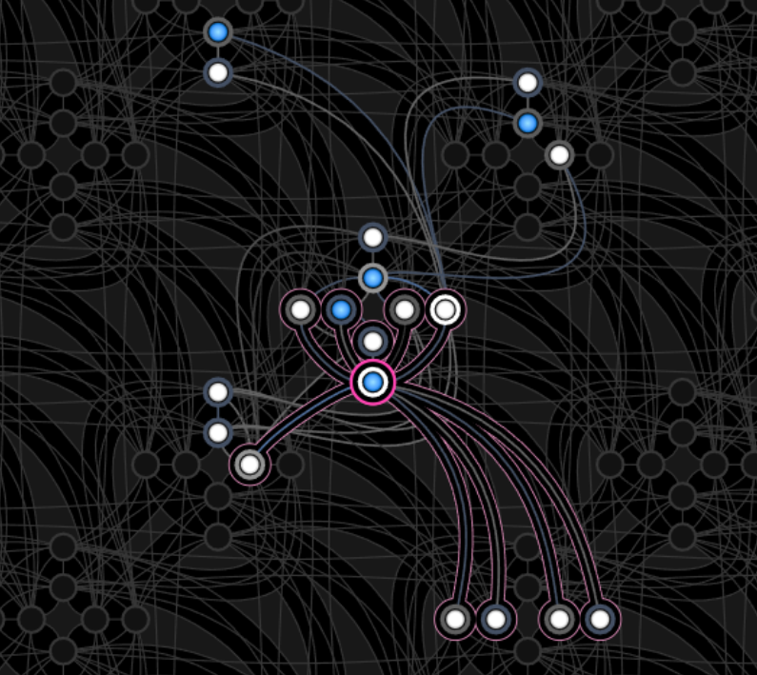
Example:
QUBO-Mapping in quantum annealers
$$−43y_{1}−240x_{0}−240x_{2}+96y_{1}x_{0}+ 96y_{1}x_{2}$$

Slide 34
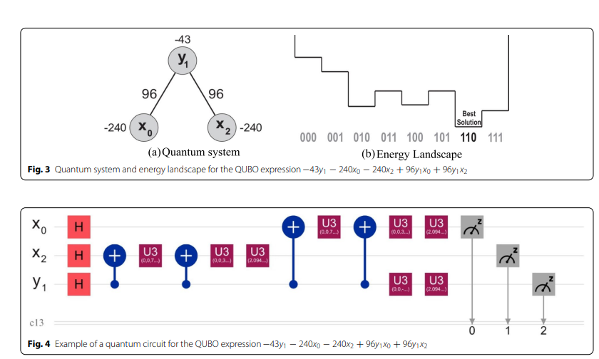
Example:
QUBO-Mapping in quantum gates
$$−43y_{1}−240x_{0}−240x_{2}+96y_{1}x_{0}+ 96y_{1}x_{2}$$

Slide 35
Example:
QUBO-Mapping in quantum gates
Hands-on practice
Jupyter Notebook
https://github.com/HIVE-AI-Studio/QuantumDay

Slide 36



Spatial Optimization Example:
Using quantum computing to solve the maximal covering location problem -2022
https://link.springer.com/article/10.1007/s43762-022-00070-x
https://github.com/alejogq/QuantumR

Slide 37
Conclusions

Slide 38
Conclusions:
Quantum computing is showing clear advantages in speeding up many optimization methods. However, only a few have demonstrated true exponential improvements, leaving plenty of room for future exploration.
Researchers agree that heuristics and metaheuristics will likely remain powerful tools for solving optimization problems, even in quantum environments.
Promising techniques—such as Quantum Gradient Descent and the Quantum Approximate Optimization Algorithm—are opening new possibilities for tackling high-dimensional challenges.
At the same time, creative ideas continue to emerge, like innovative attempts to solve the Traveling Salesman Problem using just a single qubit, showing how dynamic and evolving this field continues to be.

Slide 39
Conclusions:
There are many studies using QUBO transformations, and numerous ways to perform this mapping—from the use of slack variables to handling decoherence effects.
However, we still need comprehensive reviews focused on specific optimization problems.
Because control theory is closely related to optimization, this area offers many opportunities for research and collaboration.
There is strong potential both in theoretical exploration and in applied implementations.
Finally, we hope this review will inspire more researchers to join and contribute to this exciting field.

Slide 40
Thanks !!

